Slide 1
Multi-Threading on UNIX
Lecture 10 (B)

Slide 2
Basic concepts of multi-threading
Part 1
from your OS textbook Chap. 4

Slide 3

What is a thread?
an instruction execution sequence in a process

Slide 4
What is a thread?
Demo: thread_demo
main ()
Thread 01
Thread 02
pthread_create ()
mile-stone 1
mile-stone 1
time
mile-stone 2
mile-stone 2
mile-stone 3
mile-stone 3
pthread_join ()

Slide 5
What is a thread?
a thread has its own “context”
  register file content
  stack

Slide 6
What is a thread?
separate context for a thread
a thread has its own “context”
  register file content
  stack

Slide 7
What is a thread?
all threads share the same memory content
shared by all threads

Slide 8
What is a thread
DEMO: pthread_basic
  global variables value and flag shared by all threads
thread. 1
thread. 2
/* initial: flag = 0 */
value = 100;
flag = 1;
while (flag==0);
print value;

Slide 9
What is a thread?
Summary
  a thread is an instruction execution sequence in a process
  each thread has its own context
    register file content
    stack
  all threads in a process share the same memory space

Slide 10
Why multi-threading

Slide 11
Why multi-threading?
Responsiveness
Resource sharing
Economy
Utilization of multiprocessor architecture

Slide 12
Why multi-threading?
Responsiveness
  Example: Web-browser do the following simultaneously
    receiving a image/video from Internet and decompressing
    waiting for your input from a dialog box

Slide 13
Why multi-threading?
Responsiveness
Resource sharing
Economy
Utilization of multiprocessor architecture
time
Demo: pthread_run
CPU 1
thread 1
CPU 2
thread 2

Slide 14
Why multi-threading?
Recall: fork() duplicates the whole memory space of a process
Resource sharing
Economy
shared by all threads

Slide 15
How to create a new process?
fork and generate a process with identical content
Parent Process
Child Process
pid = fork ();
if (pid==0) {//child process
execlp (filename, filename, (void*)0);
printf (“Error if you see this line\n”);
}
else { //parent process
printf (“This is in parent process\n”);
}
pid = fork ();
if (pid==0) {//child process
execlp (filename, filename, (void*)0);
printf (“Error if you see this line\n”);
}
else { //parent process
printf (“This is in parent process\n”);
}
fork
identical copy to the parent process

Slide 16
Multi-threaded programming on UNIX
Part 2
the pthread system call families

Slide 17
UNIX support for multi-threading
create and terminate a thread
  pthread_create
  pthread_exit
  pthread_join
thread synchronization
  pthread_mutex_init
  pthread_mutex_destroy
  pthread_mutex_lock
  pthread_mutex_trylock
  pthread_mutex_unlock

Slide 18
Thread creation and termination
pthread_create, pthread_exit, and pthread_join

Slide 19
Creating a thread
pthread_create (*thread_id, *attribute, start_addr, *argument)
  thread_id: location to store the ID of a thread after creation
  start_addr: starting address of executing the thread
  argument: memory location for arguments to start executing the thread

Slide 20
Terminating a thread
just return from the starting subroutine
  return a pointor to the execution result
call pthread_exit (*result)

Slide 21
Wait for a thread to terminate
pthread_join (thread_id, **result)

Slide 22
Demo: pthread_basic
thread. 1
thread. 2
/* initial: flag = 0 */
value = 100;
flag = 1;
while (flag==0);
print value;

Slide 23
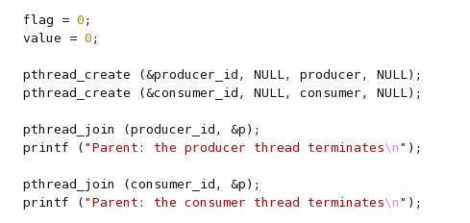
Demo: pthread_basic

Slide 24
Demo: pthread_basic
create a thread to start execution from function producer ()

Slide 25
Demo: pthread_basic
wait for a thread to terminate

Slide 26
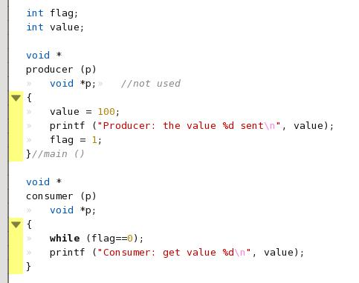
Demo: pthread_basic
thread. 1
thread. 2
/* initial: flag = 0 */
value = 100;
flag = 1;
while (flag==0);
print value;

Slide 27
Mutual exclusive and critical section for multi-threading

Slide 28
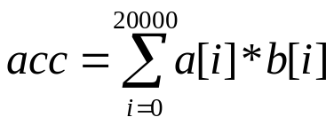
Recap: A program with bug
doing dot-product with two processors
Proc. 1
Proc. 2
mysum = 0;
for (i=0;i<10000;i++)
mysum += a[i]*b[i];
acc += mysum;
mysum = 0;
for (i=10000;i<20000;i++)
mysum += a[i]*b[i];
acc += mysum;
acc
shared memory

Slide 29
Recap: A program with bug (cont’d)
Detailed view: the trace of two processors
P0
P1
...
...
/* mysum == 5 */
/* mysum == 10 */
acc = acc + mysum;
acc = acc + mysum;

Slide 30
Recap: A program with bug (cont’d)
Detailed view: the trace of two processes
P0
P1
...
...
/* mysum == 5 */
/* mysum == 10 */
acc = acc + mysum;
acc = acc + mysum;
/* R0 == mysum == 5 */
R1 = mem [Acc] //load
R2 = R1 + R0
mem[Acc] = R2 //store

Slide 31
A program with bug (cont’d)
Detailed view with assembly
P0
P1
/* R0 == mysum == 5 */
/* R0 == mysum == 10 */
R1 = mem [acc];
R1 = mem [acc];
R2 = R1 + R1;
R2 = R1 + R1;
trace
mem[acc] = R2;
mem[acc] = R2;

Slide 32
A program with bug (cont’d)
With timing
P0
P1
/* R0 == mysum == 5 */
/* R0 == mysum == 10 */
R1 = mem [acc];
R2 = R1 + R1;
time
mem[acc] = R2;
correct answer
acc=15
obtained
R1 = mem [acc];
R2 = R1 + R1;
mem[acc] = R2;

Slide 33
A program with bug (cont’d)
With timing
P0
P1
/* R0 == mysum == 5 */
/* R0 == mysum == 10 */
R1 = mem [acc];
time
R1 = mem [acc];
R2 = R1 + R1;
R2 = R1 + R1;
incorrect answer
acc=10
obtained
mem[acc] = R2;
mem[acc] = R2;

Slide 34
A program with bug (cont’d)
With timing
P0
P1
/* R0 == mysum == 5 */
/* R0 == mysum == 10 */
R1 = mem [acc];
time
R1 = mem [acc];
R2 = R1 + R1;
R2 = R1 + R1;
incorrect answer
acc=5
obtained
mem[acc] = R2;
mem[acc] = R2;

Slide 35
The correct program
Proc. 1
Proc. 2
mysum = 0;
for (i=0;i<10000;i++)
mysum += a[i]*b[i];
lock (L);
acc += mysum;
unlock (L);
mysum = 0;
for (i=10000;i<20000;i++)
mysum += a[i]*b[i];
lock (L);
acc += mysum;
unlock (L);
acc
shared memory

Slide 36
System calls for mutual-exclusive synchronization for multi-threading
thread synchronization
  pthread_mutex_init
  pthread_mutex_destroy
  pthread_mutex_lock
  pthread_mutex_trylock
  pthread_mutex_unlock

Slide 37
Demo: pthread_acc
Thread 1
Thread 2
Thread 3
Thread 4
acc = acc + …;
acc = acc + …;
acc = acc + …;
acc = acc + …;
acc
shared memory

Slide 38
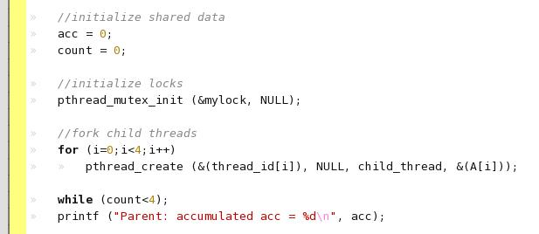

Demo: pthread_acc
initialize a lock

Slide 39
Demo: pthread_acc
initialize a lock
the lock variable

Slide 40
Demo: pthread_acc
initialize a lock
initializing the lock

Slide 41
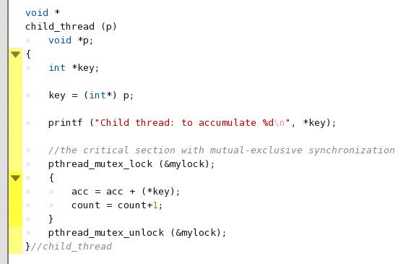
Demo: pthread_acc
the critical section

Slide 42
Demo: pthread_acc
the critical section
the critical section

Slide 43
Demo: pthread_acc
create threads and pass parameters
create threads

Slide 44
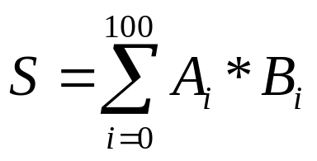
In-Class Exercise
write a dot-product with pthread
  you may modify from pthread_acc

